Slide 1



Deep Dive into Yardi: Understanding Voyager, Breeze, and Elevate
Notes:
1

Slide 2
Yardi at a Glance: Revolutionizing Real Estate Management
Pioneering Property Software
Integrated Solutions
Tailored Platforms
Founded as a leader in property management software, Yardi serves diverse portfolios worldwide.
Offers solutions spanning accounting, leasing, maintenance, marketing, and analytics.
Platforms are designed for different business sizes and needs: Voyager, Breeze, and Elevate.
Notes:
2

Slide 3


Yardi Voyager: The Enterprise Powerhouse
Comprehensive Coverage
Advanced Functionality
Cloud-based, end-to-end platform for large, complex portfolios including multifamily, commercial, senior, and affordable housing.
Features integrated accounting compliant with GAAP and IFRS, customizable workflows, and comprehensive reporting.
Global Reach
Trusted Control
Enables global operations with multi-region, multi-currency support and mobile access.
Trusted by large property managers and investors for robust financial and operational control.
Notes:
3

Slide 4
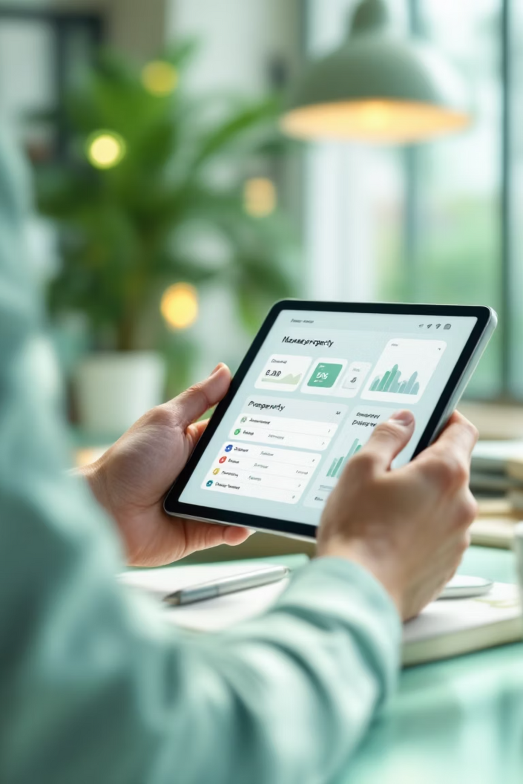
Yardi Breeze: Simplicity Meets Efficiency for Small to Mid-Sized Managers
User-Friendly Design
Designed for smaller portfolios with an intuitive, mobile-friendly interface.
Core Features
Includes tenant and lease management, basic accounting, rent collection, and maintenance tracking.
Marketing Tools
Offers marketing tools for online listings and tenant applications.
Scalable Growth
Seamless upgrade path to Voyager as business scales, preserving data continuity.
Notes:
4

Slide 5
Yardi Elevate: Intelligence and Automation for Commercial Assets
Yardi Elevate is a specialized suite focused on maximizing commercial real estate asset performance and operational efficiency.
1
Integrated Suite
2
Automated Workflows
Integrates Construction Manager, Facility Manager, Floorplan Manager, Forecast Manager, and Valuation Manager for a holistic view.
Automates work orders, preventive maintenance, and vendor management to significantly reduce costs and downtime.
3
Real-Time Insights
4
Mobile Empowerment
Dashboards provide instant insights into NOI, operating costs, and project forecasting, enabling proactive decision-making.
Mobile apps empower technicians and managers with on-the-go updates and inspection capabilities, improving field efficiency.
Notes:
5

Slide 6

Real-World Impact: How Yardi Transforms Property Management
  Big V Property Group: Facility Manager's automation led to reduced maintenance costs and improved tenant satisfaction.
  Construction Efficiency: Construction Manager streamlines contract bidding and vendor selection, accelerating project timelines.
  Accurate Forecasting: Forecast Manager replaces error-prone spreadsheets with rolling forecasts, significantly improving budgeting accuracy.
  Increased Occupancy: Breeze's marketing tools simplify online listings and tenant screening, helping small landlords boost occupancy rates.
Notes:
6

Slide 7

Why Choose a Single Integrated Platform?
Eliminate Data Silos
Enhanced Visibility
Yardi’s unified ecosystem prevents costly data fragmentation and manual reconciliation across systems.
Provides full operational visibility from leasing to asset management, enabling smarter investment decisions.
Reduced Complexity
Modern Tenant Experience
Lowers IT complexity and total cost of ownership compared to fragmented, best-of-breed software solutions.
Supports compliance, energy management, and robust resident self-service to meet modern tenant expectations.
Notes:
7

Slide 8

The Future with Yardi: AI and Innovation
AI Innovation
Client Feedback
Sustainability
Staff Training
Yardi is committed to continuous innovation, driven by client feedback and a focus on future-proofing real estate operations.
Notes:
8

Slide 9



Choosing the Right Yardi Solution for Your Business
Small to Mid-Sized Portfolios
Growing or Complex Portfolios
Commercial Real Estate Firms
Start with Yardi Breeze for its ease of use, intuitive interface, and rapid deployment. Ideal for property managers seeking efficient core functionalities without overwhelming complexity.
Transition seamlessly to Yardi Voyager for enterprise-grade capabilities, comprehensive financial management, and advanced reporting. Perfect for large-scale operations with diverse asset classes.
Leverage the Yardi Elevate Suite for specialized operational intelligence, asset performance optimization, and cost control. Focuses on commercial-specific needs like construction, facility, and valuation management.
Our customizable and scalable solutions ensure a long-term partnership that supports your growth.
Notes:
9

Slide 10



Conclusion: Elevate Your Property Management with Yardi
Yardi’s platforms empower property professionals to optimize operations, reduce costs, and enhance tenant experiences.
100%
75%
90%
Optimization of operations
Reduction in costs
Enhanced tenant experiences
Whether starting small or managing vast portfolios, Yardi offers a tailored, integrated solution. Embrace Yardi to future-proof your real estate business with technology that drives efficiency and growth.
Notes:
10

