Slide 1


Property Financial Management: Decision Checklist
Choosing Between Property Management Software, Accounting Services, or a Hybrid Approach
A comprehensive guide for property owners, managers, and CFOs to make informed decisions about their financial management infrastructure.
Notes:
1

Slide 2

Why Your Choice Matters More Than Ever
ROI Optimization
Regulatory Compliance
Operational Excellence
The right solution can increase your portfolio's profitability by 15-25% through improved operational efficiency and reduced overhead costs.
Avoid costly penalties and legal issues with proper financial reporting, tax compliance, and audit-ready documentation.
Streamlined processes reduce manual errors, improve tenant satisfaction, and free up time for strategic growth initiatives.
Today's property management landscape demands sophisticated financial oversight. Whether you're managing a small portfolio or overseeing hundreds of units, the wrong approach can cost you thousands in lost revenue, compliance issues, and operational inefficiencies.
Notes:
2

Slide 3

Step 1: Assess Your Portfolio Foundation
Portfolio Size Analysis
How many units do you currently manage? Properties under 50 units have different needs than large-scale operations with 200+ units.
Property Type Complexity
Are you managing residential, commercial, mixed-use, or specialized properties? Each type requires different compliance and reporting standards.
Investor Structure
Do you have multiple investor groups requiring separate reporting? Complex ownership structures demand sophisticated accounting capabilities.
Growth Trajectory
Are you planning to expand your portfolio within the next 2-3 years? Your solution needs to scale with your ambitions.
Pro Tip: Portfolios with mixed property types or multiple investor groups typically benefit most from hybrid solutions that combine automated management with expert accounting oversight.
Notes:
3

Slide 4


Step 2: Identify Your Operational Needs
Property Management Software excels at automating day-to-day operations. Evaluate which of these capabilities are critical for your success:
Automated Rent Collection
  Online payment processing and late fee automation
  Integration with bank accounts and payment gateways
  Tenant payment history and delinquency tracking
Maintenance Management
  Work order creation, tracking, and vendor coordination
  Preventive maintenance scheduling and reminders
  Mobile access for on-site property inspections
Tenant Communication Hub
  Centralized messaging and document sharing
  Automated lease renewal and notice generation
  Tenant portal for self-service capabilities
Lease Management
  Digital lease signing and storage
  Rent escalation and lease expiration tracking
  Compliance with local rental regulations
Notes:
4

Slide 5





Step 3: Evaluate Financial Complexity
Comprehensive Bookkeeping
Advanced Financial Reporting
Professional accounting services provide meticulous transaction recording, bank reconciliation, and accounts payable/receivable management that goes beyond basic software capabilities.
Monthly financial statements, cash flow analysis, and variance reporting that meet investor-grade standards and banking requirements for financing.
Strategic Tax Planning
ROI & Performance Analysis
Proactive tax strategies including depreciation optimization, 1031 exchanges, cost segregation studies, and multi-state tax compliance for complex portfolios.
Deep-dive analytics on property performance, market comparisons, and strategic recommendations for portfolio optimization and expansion opportunities.
Notes:
5

Slide 6

Step 4: Consider Your Team's Expertise
Assess Your Current Capabilities
In-House Accounting Skills
Do you have certified accounting professionals on staff who understand real estate-specific requirements?
Technology Adoption
How comfortable is your team with learning and implementing new software systems?
Time Availability
Can your current staff handle additional financial management responsibilities without compromising other duties?
Compliance Knowledge
Are you confident in your team's ability to stay current with changing tax laws and industry regulations?
"The most successful property management companies invest in both technology and expertise. Software handles the routine tasks, while professional accountants provide the strategic insights that drive long-term profitability."
Notes:
6

Slide 7

Step 5: Determine Budget & ROI Goals
$2K
$5K
20%
Monthly Software Costs
Monthly Accounting Services
Efficiency Improvement
Typical range for comprehensive property management software serving 100+ units
Professional accounting services for mid-size portfolios with complex reporting needs
Average operational efficiency gains when implementing integrated solutions
Consider your risk tolerance and ROI expectations. Software-only solutions offer lower upfront costs but may require significant internal expertise. Full-service accounting provides comprehensive support but at higher monthly fees. Hybrid approaches balance cost with expertise, often delivering the best long-term value for growing portfolios.
Factor in hidden costs like training time, integration complexity, and potential compliance penalties when making budget decisions.
Notes:
7

Slide 8

Step 6: Choose Your Strategic Approach
Software-Only Approach
Accounting Services Only
Hybrid Approach
Best for: Small portfolios (under 50 units) with simple ownership structures
Best for: Portfolios prioritizing financial accuracy over operational automation
Recommended for: Mid-to-large portfolios seeking optimal balance
  Lower monthly costs
  Expert financial management
  Automated operations + expert accounting
  Direct control over data
  Comprehensive compliance coverage
  Requires strong in-house expertise
  Limited operational efficiency gains
  Scalable and future-ready
Risk: Compliance gaps and limited strategic insights
Risk: Manual processes and higher operational costs
  Higher upfront investment
Advantage: Maximum ROI and comprehensive coverage
Notes:
8

Slide 9
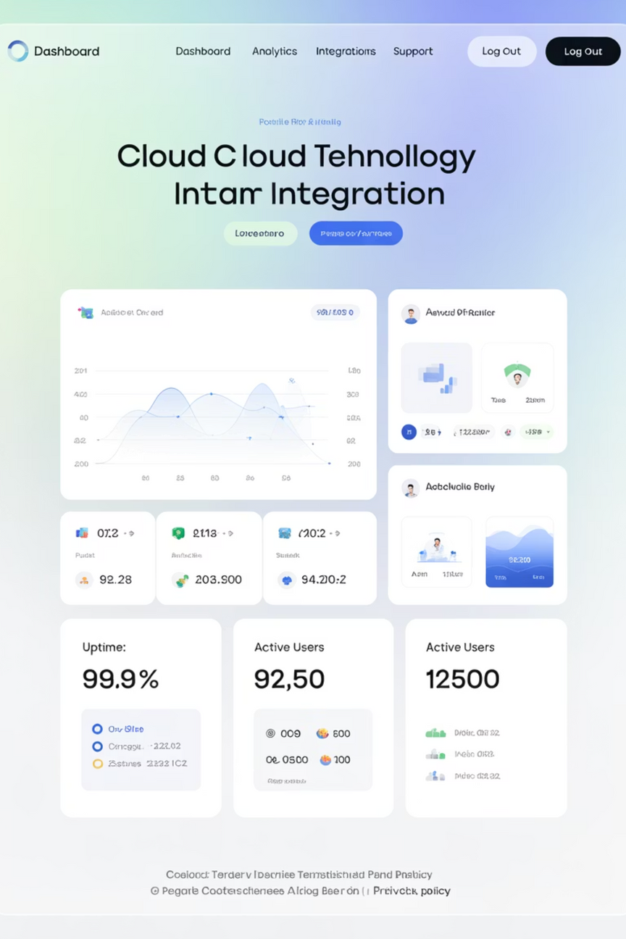
Step 7: Integration & Technology Assessment
Data Synchronization
Evaluate how well your chosen software integrates with existing accounting systems, banking platforms, and reporting tools. Seamless data flow prevents manual entry errors and saves countless hours.
Dashboard Capabilities
Assess the quality of real-time reporting dashboards. Can stakeholders access key metrics instantly? Do reports meet investor and lender requirements?
API Connectivity
Ensure your solution can connect with third-party tools like QuickBooks, banking APIs, background check services, and marketing platforms for comprehensive workflow automation.
Mobile Accessibility
Verify that critical functions are accessible via mobile apps. Property management is a field-intensive business requiring on-the-go access to tenant information, maintenance requests, and financial data.
Notes:
9

Slide 10




Future-Proof Your Investment
Scalability Planning
Choose solutions that can grow with your portfolio. Can the system handle 5x your current property count without major overhauls?
AI & Automation Readiness
Embrace platforms that integrate predictive analytics, automated tenant screening, and intelligent maintenance scheduling for competitive advantage.
Regulatory Adaptability
Ensure your provider stays current with evolving regulations, from fair housing laws to emerging data privacy requirements.
Key Takeaway: For most mid-to-large portfolios, a hybrid approach combining robust property management software with expert accounting services delivers optimal ROI, compliance assurance, and operational excellence. Start by assessing your portfolio complexity, then match operational needs with financial expertise requirements.
Notes:
10

Slide 11

THANK YOU
Visit Our Website For More Usefull Insights
CONTACT US
+1-646-367-8976
www.outsourcinghubindia.com
Notes:
10

