Slide 1


Ultimate Propertyware Customization Checklist
Unlock the full potential of Propertyware by tailoring the platform to your unique property management needs. Proper customization enhances efficiency, accuracy, and owner satisfaction. This guide provides a step-by-step approach to optimizing your Propertyware experience.
Notes:
1

Slide 2




Introduction
Tailoring Propertyware for Peak Performance
This checklist guides property managers and operations teams through the process of customizing Propertyware dashboards, fields, and workflows. By aligning the software with your specific operational needs, you can streamline processes, improve data accuracy, and ultimately enhance the satisfaction of both your residents and property owners.
Custom Dashboards
Tailored Fields
Automated Workflows
Gain real-time insights.
Capture precise data.
Boost operational efficiency.
Notes:
2

Slide 3

Phase 1: Foundation & Planning
Assess Objectives and Map Data
Before diving into the platform, it's crucial to understand your current state and future goals. This phase focuses on internal assessment and meticulous data mapping.
Identify Key Workflows
  Leasing & Tenant Onboarding
  Maintenance & Repairs
  Owner Reporting & Accounting
Determine Critical Data Points
  Pet information
  Lease specific dates
  Inspection scores
Best Practice:
Document current processes and pain points. Engage all relevant stakeholders (property managers, accounting, leasing teams) to gather comprehensive insights.
Custom Fields Mapping Template
Field Name
Data Type
Purpose/Use Case
Pet Type
Dropdown
Track tenant pet info
Last Inspection Date
Date
Maintenance scheduling
Lease Renewal Status
Dropdown
Renewal reminders
Notes:
3

Slide 4

Phase 2: Configuration
Build Custom Fields & Dashboards
With your data mapped, it's time to bring those requirements to life within Propertyware. This involves configuring custom fields and designing dashboards that provide actionable insights.
Configure Custom Fields
Design Custom Dashboards
  Navigate to Admin > Custom Data Fields.
  Access Dashboard Builder in Propertyware.
  Create each custom field from your mapping template, paying close attention to data types (Text, Number, Date, Dropdown, etc.).
  Identify key performance indicators (KPIs) and metrics relevant to your objectives (e.g., occupancy rate, maintenance response time, rent collection).
  Set visibility and permissions to ensure only relevant teams can view and edit.
  Create dashlets for each KPI, utilizing filters and appropriate data sources to visualize critical information at a glance.
Sample Dashboard Layout:
Configuration Example:
Field Name: Pet Type
Dashlet Name
Data Source
Filters
Visual Type
Type: Dropdown
Occupancy Rate
Property Portfolio Data
Date Range
Pie Chart
Options: Dog, Cat, Other
Maintenance Status
Maintenance Requests
Status
Bar Chart
Visibility: Property Managers, Leasing Team
Required: No
Best Practice: Use standardized naming conventions for fields and dashlets to maintain consistency and avoid duplication. Leverage color-coding and real-time data updates for quick decision-making on dashboards.
Notes:
4

Slide 5





Phase 3: Automation
Automate Workflows and Business Rules
Propertyware's workflow automation capabilities can dramatically reduce manual tasks and improve responsiveness.
Lease Renewal Reminders
Maintenance Assignment
Owner Reporting Dispatch
Automated email notification 90 days before lease end, prompting action from property managers.
Auto-assign maintenance requests based on property location and vendor availability, speeding up resolution.
Schedule automatic delivery of performance reports to owners monthly, ensuring timely communication.
Example Workflow Template:
Trigger: Lease ending within 90 days
Action: Send email to property manager, create renewal checklist task
Notification: Owner to be notified about upcoming renewal
Best Practice: Test workflows with a small group of users before wide deployment to identify and resolve any issues. Prioritize automation for tasks that are repetitive, time-consuming, or prone to human error.
Notes:
5

Slide 6
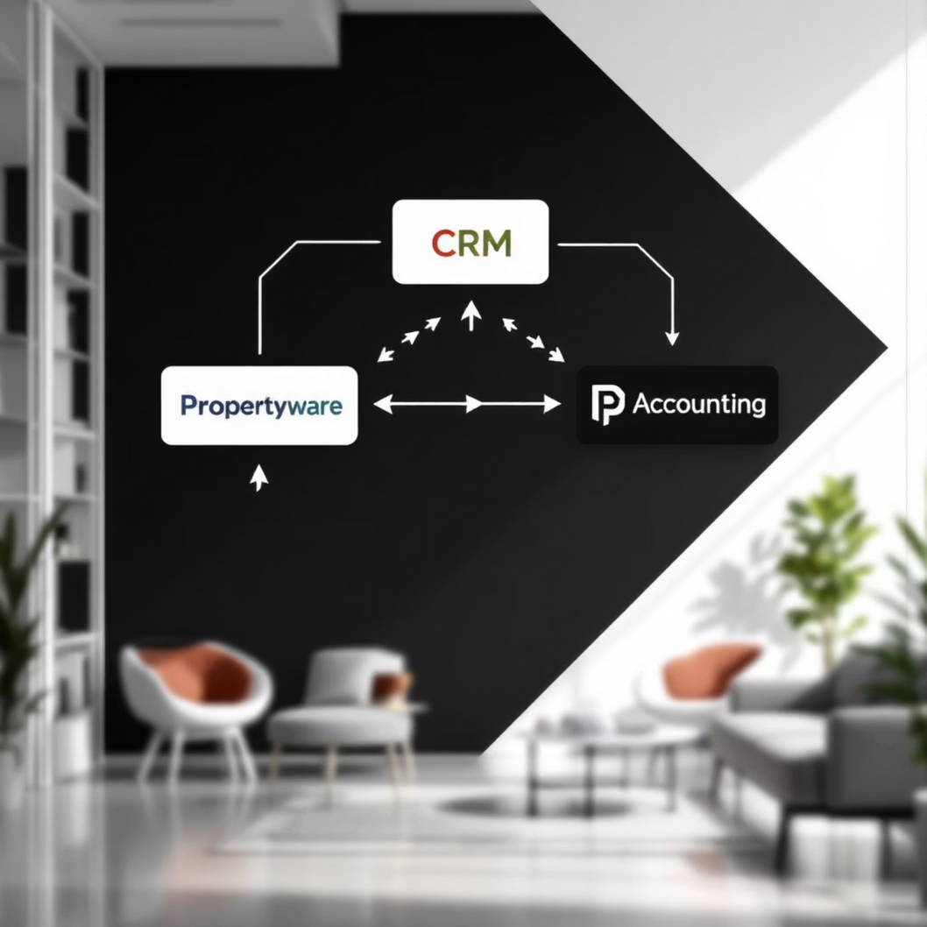
Phase 4: Integration
Connect Propertyware with External Tools
Propertyware's Open API allows seamless integration with other critical business systems, creating a unified ecosystem for your property management operations.
  Utilize Open API configurations to connect Propertyware with accounting software, CRM systems, or custom tools.
  Document API endpoints and data mappings thoroughly to ensure consistent and accurate data flow between systems.
  Consider integrations for tasks like syncing tenant contact data to your CRM or pushing maintenance data to a third-party vendor portal.
API Connectivity
Leverage Propertyware's robust API for custom integrations.
CRM Integration
Sync tenant and owner data for enhanced relationship management.
Accounting Sync
Streamline financial reconciliation and reporting.
Best Practice: Maintain versioned API documentation and schedule periodic reviews to ensure integrations remain stable and efficient as systems evolve.
Notes:
6

Slide 7

Phase 5: Validation & Training
Test, Validate, and Empower Your Team
After implementing customizations, thorough testing and comprehensive team training are paramount to ensure successful adoption and long-term effectiveness.
Test and Validate Customizations
Train Your Team & Document Best Practices
  Conduct User Acceptance Testing (UAT) with key stakeholders from each department impacted by the changes.
  Create training materials tailored to each user role, focusing on how the new customizations impact their daily tasks.
  Verify data accuracy, visibility, and ease of use across all new fields, dashboards, and workflows.
  Schedule hands-on training sessions and refresher courses to reinforce learning.
  Gather feedback from users and actively refine customizations based on their input.
  Develop quick-reference guides for common tasks involving the new customizations.
Best Practice: Keep a detailed Change Log for all adjustments made. This ensures traceability and aids in troubleshooting future issues.
Sample Training Checklist:
  Adding and editing custom fields
  Building dashboards and reports
  Automating workflows and alerts
Notes:
7

Slide 8




Phase 6: Continuous Improvement
Monitor, Optimize, and Update
Propertyware customization isn't a one-time project; it's an ongoing process. Regular monitoring and optimization ensure your platform remains aligned with evolving business needs.
Regular Performance Review
Review KPI performance and user feedback monthly to identify areas for further refinement or new customization opportunities.
Adjust & Refine
Proactively adjust dashboards, workflows, and custom fields based on changing operational requirements or market shifts.
Stay Updated on Releases
Monitor Propertyware release notes and updates to leverage new features that can further enhance your customizations.
Best Practice: Schedule quarterly or bi-annual deep-dive sessions with key users and department heads to collectively review system usage and identify potential enhancements.
Notes:
8

Slide 9
Final Tips & Best Practices
To maximize the benefits of Propertyware customization and ensure long-term success, keep these core principles in mind.
Avoid Over-Customization
Standardize Naming Conventions
Document All Customizations
Too many custom fields or overly complex workflows can complicate data management and user experience. Focus on impact over quantity.
Consistent naming for fields, dashboards, and reports enhances clarity, reduces confusion, and simplifies future maintenance.
Maintain detailed records of every custom field, workflow, and dashboard configuration. This is invaluable for onboarding new staff and troubleshooting.
Prioritize Automation
Leverage Templates
Identify and automate tasks that recur frequently. This frees up your team for more strategic activities and reduces errors.
Utilize pre-built Propertyware templates and best practice configurations whenever possible to accelerate setup and ensure robust design.
Notes:
9

Slide 10

Empower Your Property Management Operations
By systematically customizing Propertyware, you are not just configuring software; you are building a tailored solution that fits your specific workflows and reporting needs. This structured approach ensures efficiency, accuracy, and scalability for your property management business.
Start optimizing your Propertyware platform today!
Notes:
10

