Slide 1
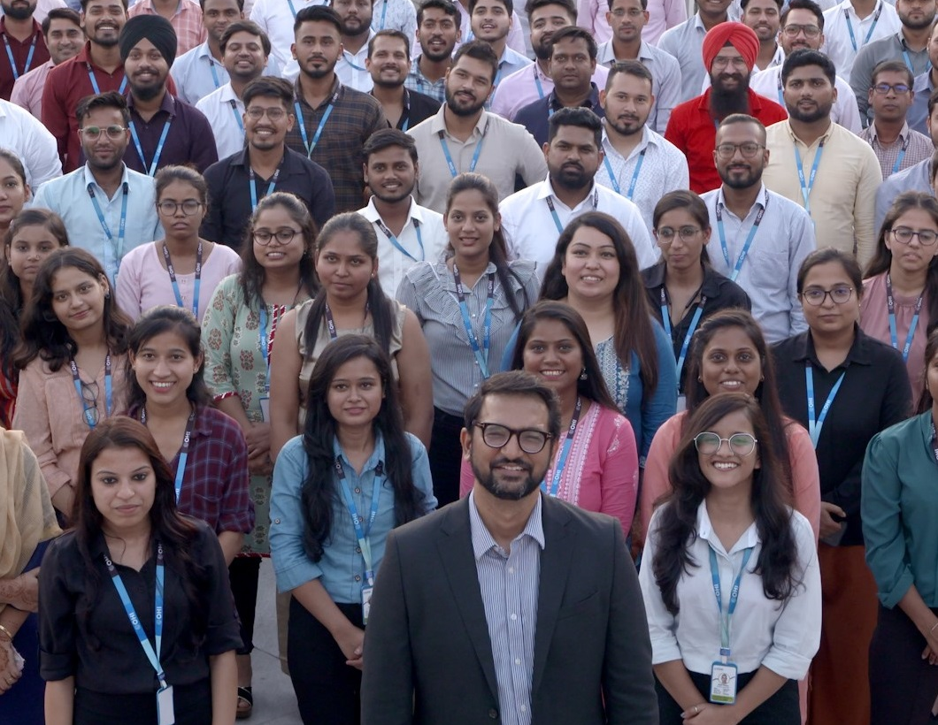




The real estate specialist since 2006
At OHI, we leverage outsourcing, automation and industry leading processes to assist you in scaling new heights of excellence. We aim to help you optimize your portfolio, acquire better, and streamline operations, all in a cost-efficient manner.
CONTACT US
150+ Real Estate Clients Across USA
Serving Eight of the Top 50 Real Estate Companies
In Business Since 2006
Serving 300,000+ Units
500+ Team
Spacious, Highly Secure Office Set-Up with Modern Facilities
Phone: 646-367-8976
sales@outsourcinghubindia.com
www.ohiaccounting.com
www.outsourcinghubindia.com
OHI BROCHURE
REAL ESTATE outsourcing
Outsourcing | Automation | Data Analytics
646-367-8976
sales@outsourcinghubindia.com
New York | Dallas | New Delhi

Slide 2


We SERVE
Owners | Developers | Asset Managers | Property Managers | Funds | REITs | HOA Managers | Family Offices
Key Sectors - Affordable Housing | Tax Credit and HUD Properties | Single Family Housing | Multifamily Housing | Homeowner Associations (HOA) | Commercial | Student Housing | Senior Housing | Retail | Industrial
OUR SERVICES
Accounts Payable and Bank Recs.
Property/Portfolio Accounting
Third Party Financial Reviews
Development Accounting
Fund Accounting
Data Visualization/BI Services
Data Management/ETL Services
Acquisition/Investment Analysis
Asset Management
Remote Property Management
Lease Administration
ESG Support Services
Treasury Administrative Support
Benefits of Outsourcing
Popular roles
Property Accountant – USD 2500/m
Development Accountant – USD 2600/m
Investment Analyst – USD 3400/m
Asset Manager – USD 3500/m
Property Manager – USD 2500/m
BI Specialist – USD 3500/m
Data Analyst – USD 3000/m
High-Cost Savings
Staffing On Demand
Focus on Core Business
Quick Work Turnaround
Enable Automation
Access to Best Practices

